Slide 1


Introduction to Python – Week 3
Mark Smith

Slide 2
Course outline
Lesson 1 – Getting Started: Introduction and Arithmetic Operators
Lesson 2 – Types and Variables
Lesson 3 – Functions
Lesson 4 – Conditional and Recursive Statements
Lesson 5 – Iteration
Lesson 6 – Strings
Lesson 7 – Lists
Lesson 8 – Dictionaries
Lesson 9 – Tuples
Lesson 10 – Project

Slide 3
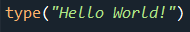
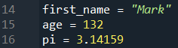
Last Week
What are Values and Types?
What is a variable?
How can we use variables?

Slide 4
This Week – Functions
Today we will learn:
What are functions?
How do we define functions?
How can we use functions in our programs?

Slide 5
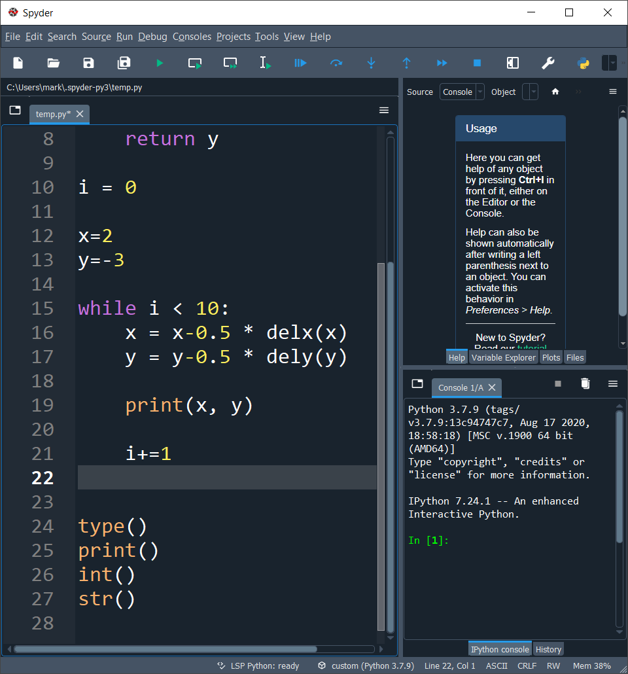
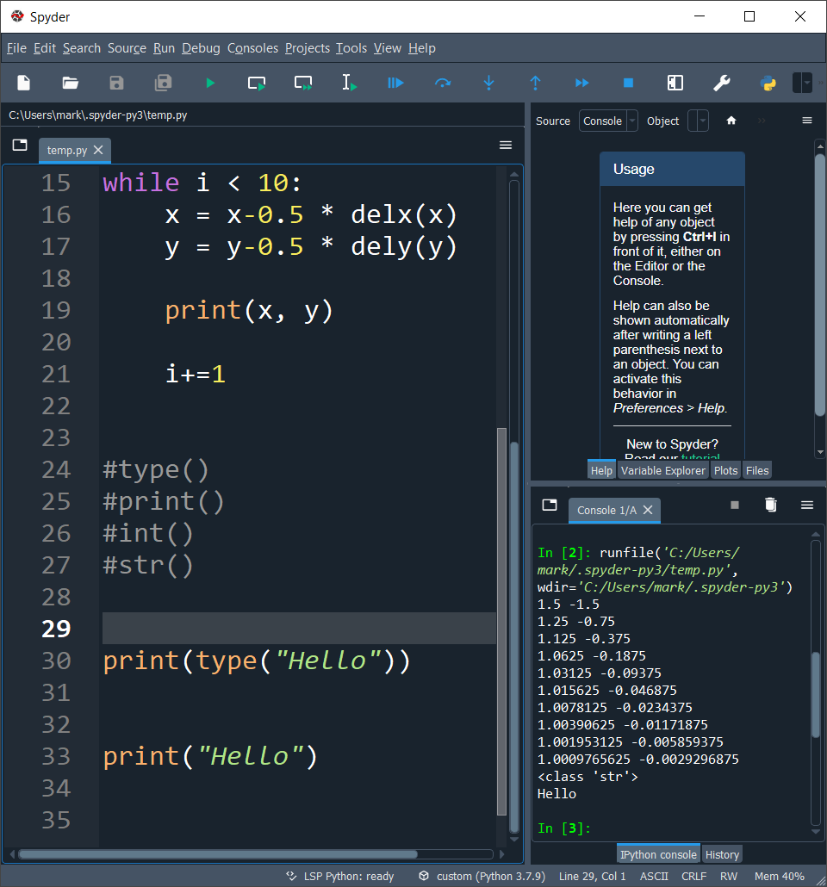
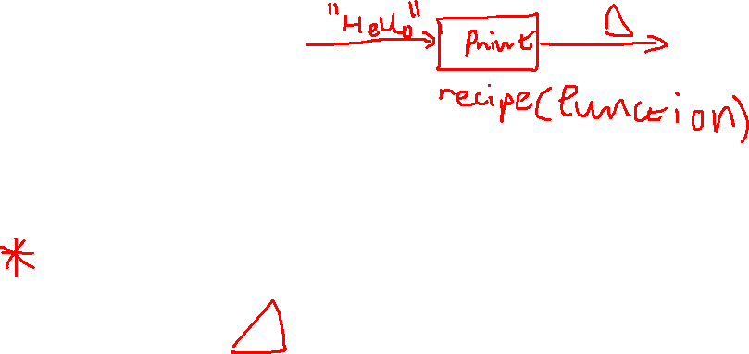
What is a function?
We have already seen some examples of functions:
A function is a named sequence of statements that performs a computation or calculation which we first define and later call by name. Functions have:
Argument
Return Value

Slide 6
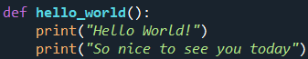
Defining functions
Now, we can define our own functions,
Note: The rules for naming functions are the same as for naming variables

Slide 7
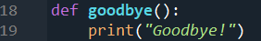
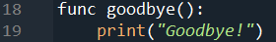
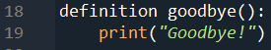
A, b or c?
A
B
C

Slide 8
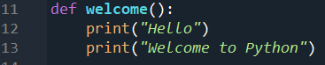


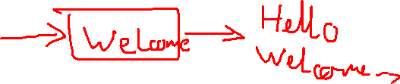
A, b or c?
A
B
C

Slide 9
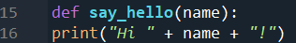
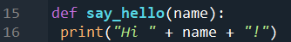

A, b or c?
A
B
C

Slide 10
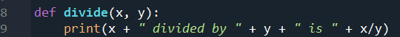


A, b or c?
A
B
C

Slide 11
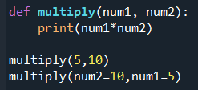
Positional and keyword arguments
There are two types of arguments:
Positional
Keyword

Slide 12
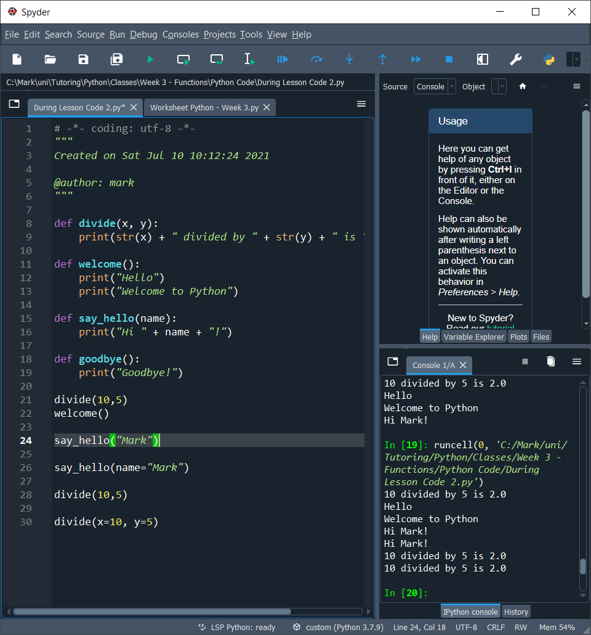
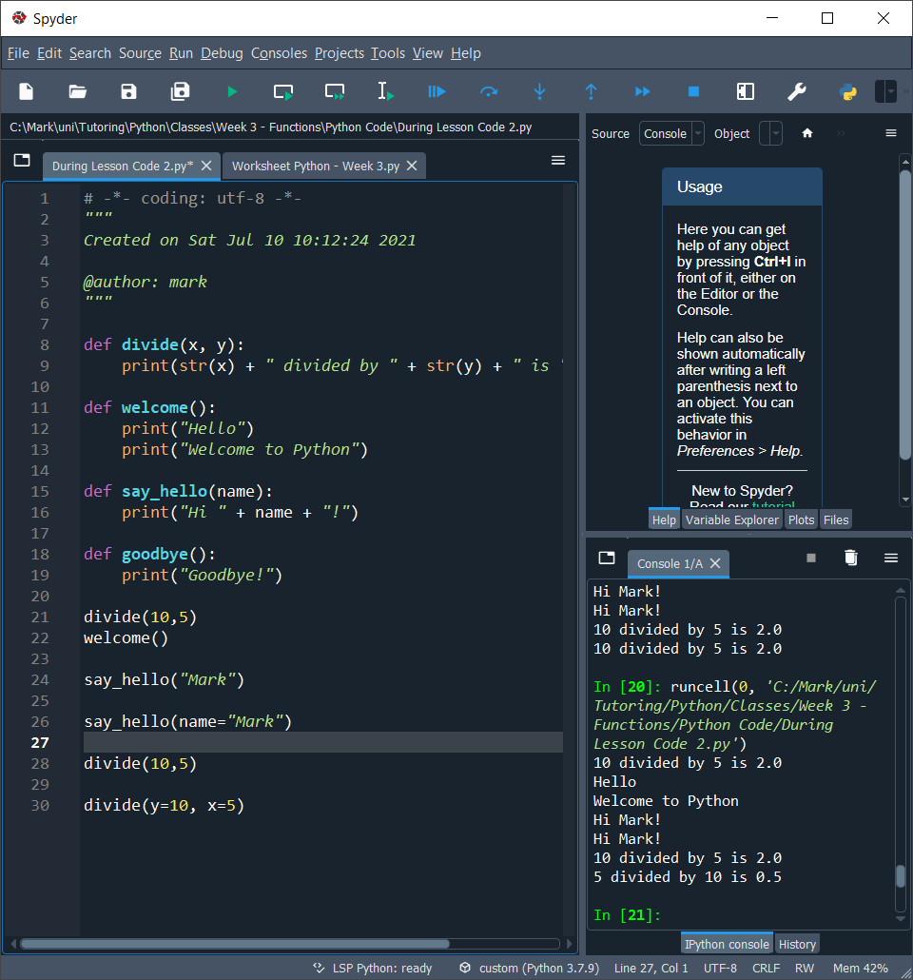
Positional or keyword?
A
B
C

Slide 13
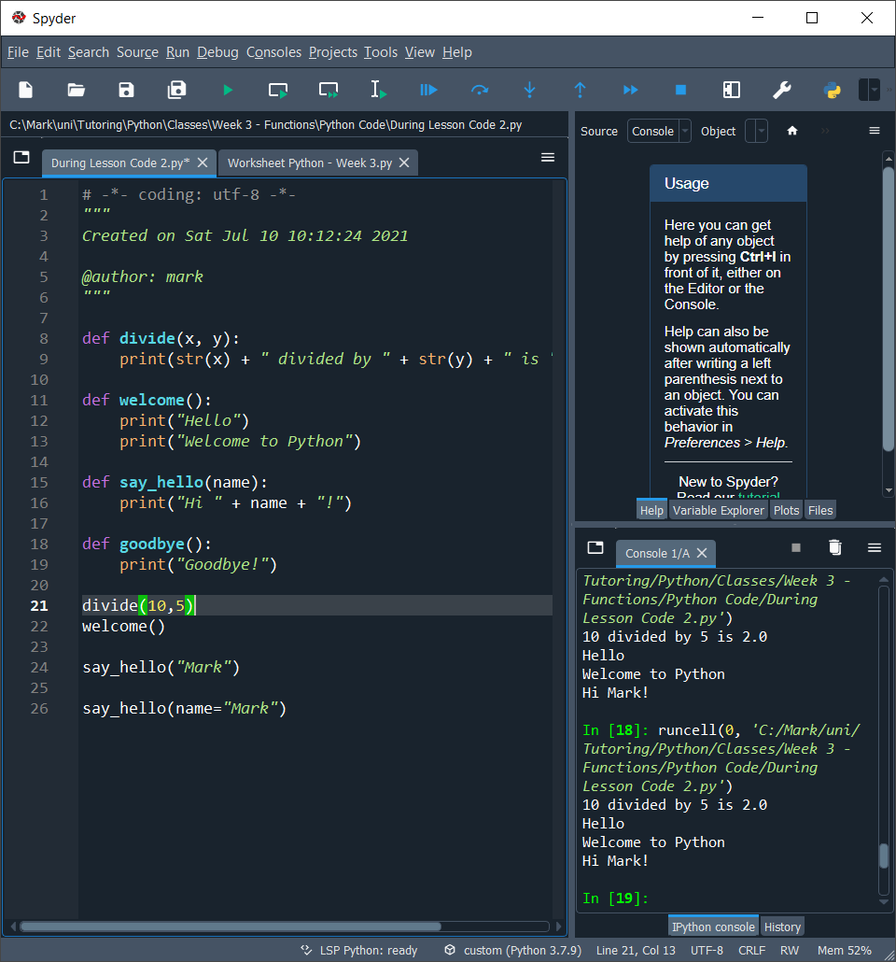
Positional or keyword?
A
B

Slide 14
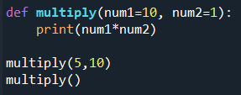
Default values for arguments
We can also set the default values for our arguments in a function definition

Slide 15
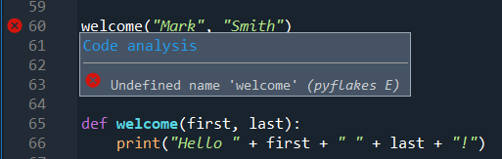
Calling function from a function
It is possible to call a function from inside another function. This allows us to perform the same task many times without writing out the code many times
We have to remember to call functions after they are defined

Slide 16
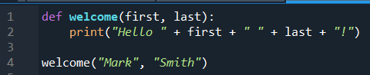
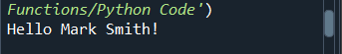
Flow of execution
Programs in Python run from top to bottom except when we use functions

Slide 17
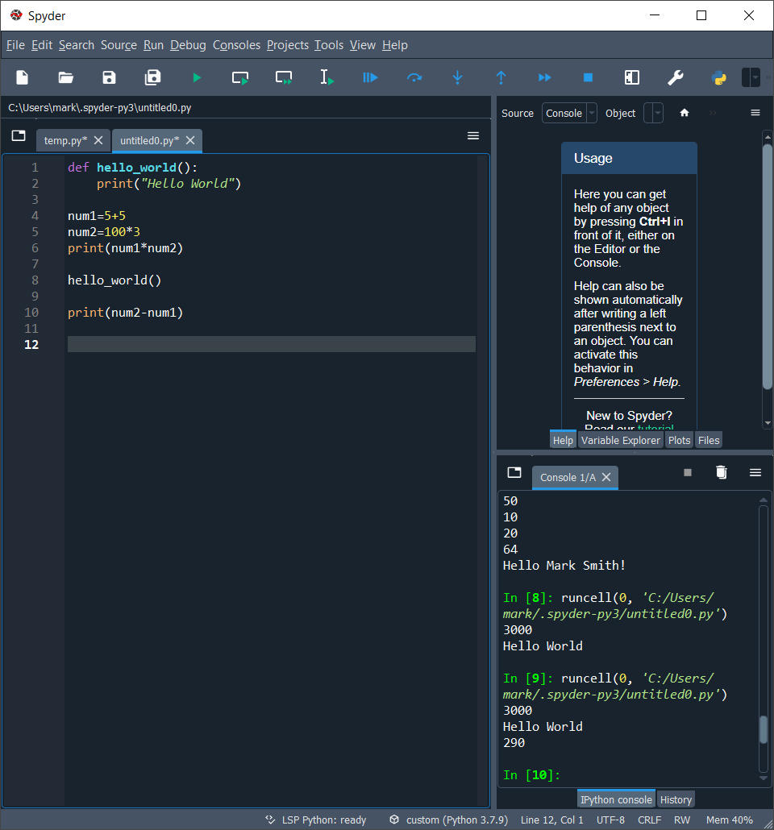
Flow of execution

Slide 18
Flow of execution

Slide 19
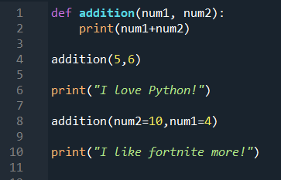
Flow of execution

Slide 20

Flow of execution

Slide 21
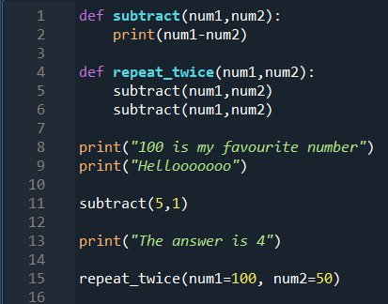
Flow of execution

Slide 22

Flow of execution

Slide 23
Variables and parameters are local
When we define variables inside a function they are local
The arguments of a function are also local

Slide 24
End of class
This week we have looked at:
What are functions
How do we define a function
How do we use arguments
Flow of execution

